Slide 1

Priority Queues and Heaps Data Structures-II
Dr. Dattatray G. Takale
Dattatray.takale@viit.ac.in
Department of Data Science
BRACT’S, Vishwakarma Institute of Information Technology, Pune-48
(An Autonomous Institute affiliated to Savitribai Phule Pune University)
(NBA and NAAC accredited, ISO 9001:2015 certified)

Slide 2
Unit -2 :Contents
Priority Queues and Heaps
Double Ended Priority queues, Leftist Trees, Binomial Heaps, Fibonacci Heaps, skew heaps, pairing heaps
Dr. Dattatray G Takale, Department of Computer Engineering, VIT, Pune-37

Slide 3
Objectives of this session
To identify the appropriate data structure and algorithm design method for a specified application.
Illustrate concept, operations of Queues as a Linear Data Structure and applying them to solve various problems.
Learning Outcomes
Dattatray G Takale, Department of Computer engineering, VIT, Pune- 411037

Slide 4
Unit -2 :Contents
Priority Queues and Heaps
Double Ended Priority queues, Leftist Trees, Binomial Heaps, Fibonacci Heaps, skew heaps, pairing heaps
Dr. Dattatray G Takale, Department of Computer Engineering, VIT, Pune-37

Slide 5
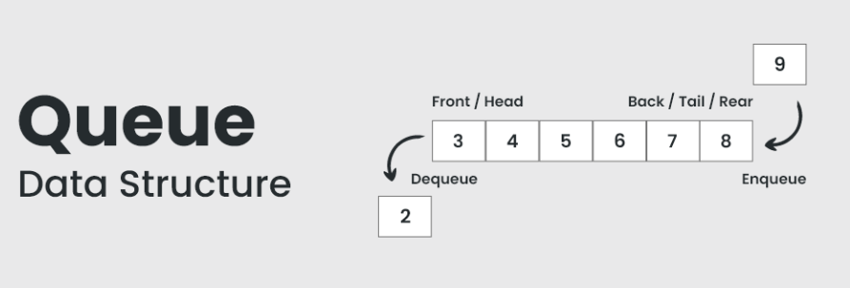
Queue
A queue is a linear data structure that follows a particular order in which operations are performed. The order is First-In-First-Out (FIFO). This means that the first element added to the queue will be the first one to be removed, just like a real-world queue or line, such as waiting in line at a grocery store.
The queue data structure follows the FIFO (First In First Out) principle where elements that are added first will be removed first.
Dattatray G Takale, Department of Computer engineering, VIT, Pune- 411037

Slide 6
Operation on Queue
Basic Operations of Queue Data Structure
Enqueue (Insert): Adds an element to the rear of the queue.
Dequeue (Delete): Removes and returns the element from the front of the queue.
Peek: Returns the element at the front of the queue without removing it.
Empty: Checks if the queue is empty.
Full: Checks if the queue is full.
Front: This operation allows you to look at the element at the front of the queue without removing it
Rear: This operation allows you to look at the element at the end of the queue, the last one to be added.
Dattatray G Takale, Department of Computer engineering, VIT, Pune- 411037

Slide 7
Application on Queue
Applications of Queue
Task scheduling in operating systems
Data transfer in network communication
Simulation of real-world systems (e.g., waiting lines)
Priority queues for event processing queues for event processing
Dattatray G Takale, Department of Computer engineering, VIT, Pune- 411037

Slide 8
Types of Queue
Simple Queue (Linear Queue): This is the basic form of a queue, where elements are enqueued at the rear and dequeued from the front.
Circular Queue: In this type of queue, the last position is connected back to the first position, forming a circle. This is useful when we want to make efficient use of space.
Priority Queue: Here, each element has a priority, and elements with higher priority are dequeued before those with lower priority, regardless of their position in the queue.
Deque (Double-Ended Queue): A deque allows elements to be added or removed from both the front and the rear.
Dattatray G Takale, Department of Computer engineering, VIT, Pune- 411037

Slide 9
Priority Queue
A Priority Queue is a type of queue (like a waiting line), but instead of serving people in the order they came (FIFO – First In, First Out), it serves people based on priority.
A priority queue is a special type of queue in which each element is associated with a priority value. And, elements are served on the basis of their priority. That is, higher priority elements are served first.
However, if elements with the same priority occur, they are served according to their order in the queue.
Assigning Priority Value
Generally, the value of the element itself is considered for assigning the priority. For example, The element with the highest value is considered the highest priority element. However, in other cases, we can assume the element with the lowest value as the highest priority element.
We can also set priorities according to our needs.
Dattatray G Takale, Department of Computer engineering, VIT, Pune- 411037

Slide 10
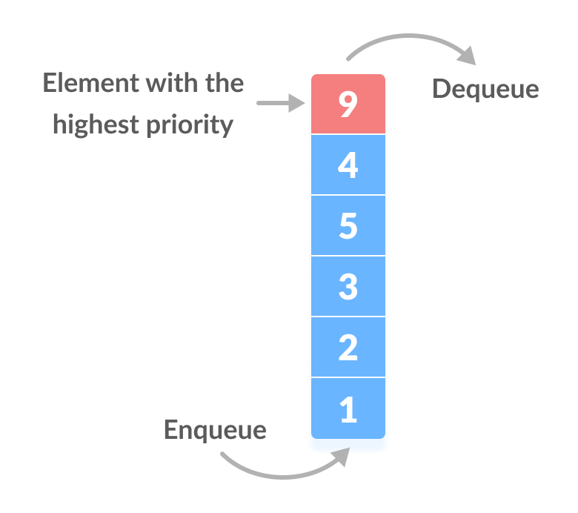
Priority Queue
Difference between Priority Queue and Normal Queue
In a queue, the first-in-first-out rule is implemented whereas, in a priority queue, the values are removed on the basis of priority. The element with the highest priority is removed first.
Priority Queue Applications
Some of the applications of a priority queue are:
Dijkstra's algorithm
for implementing stack
for load balancing and interrupt handling in an operating system
for data compression in Huffman code
Dattatray G Takale, Department of Computer engineering, VIT, Pune- 411037

Slide 11
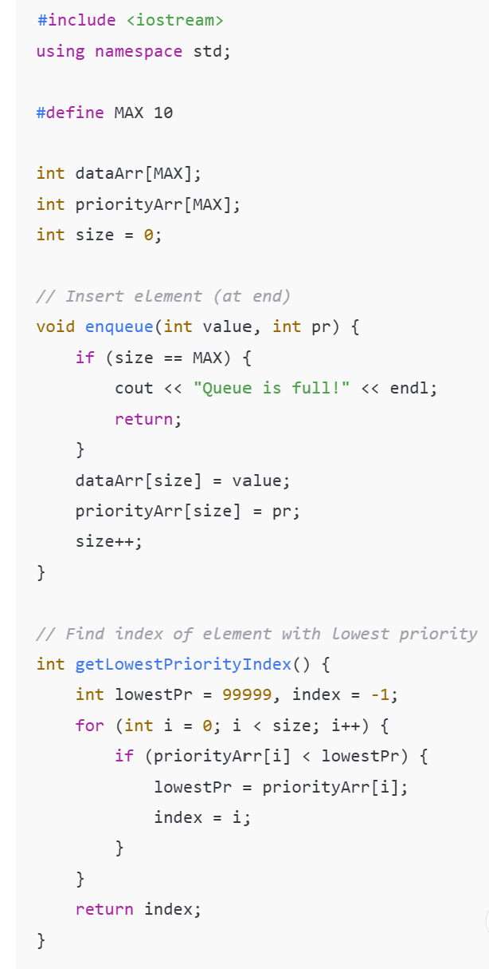
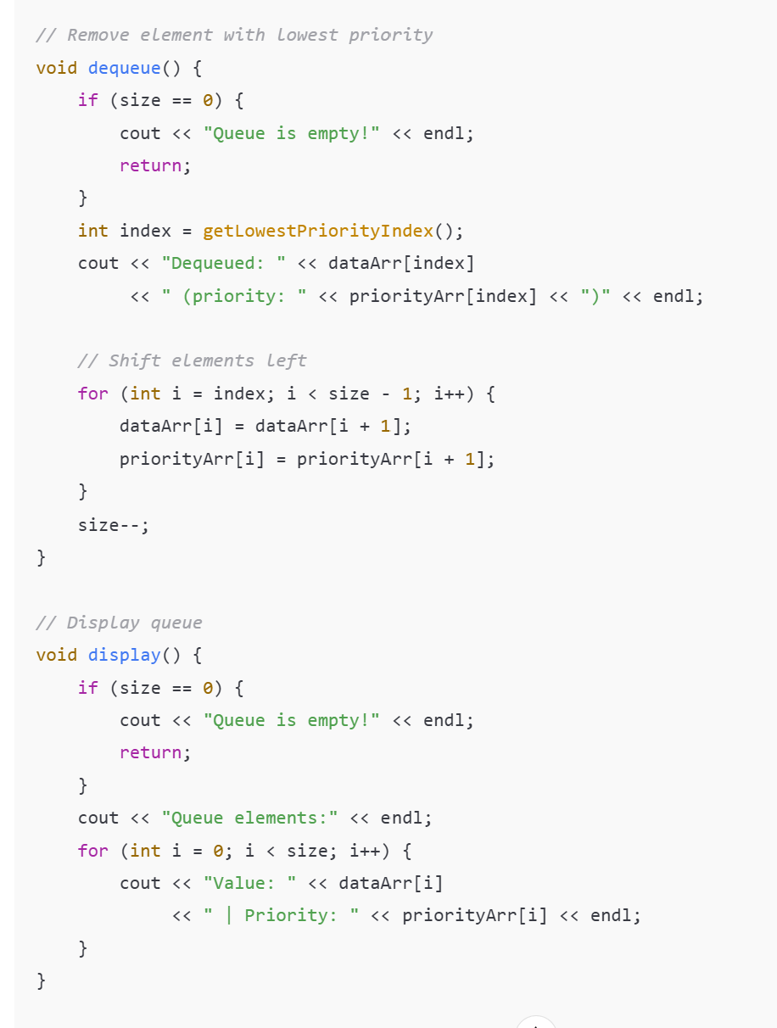
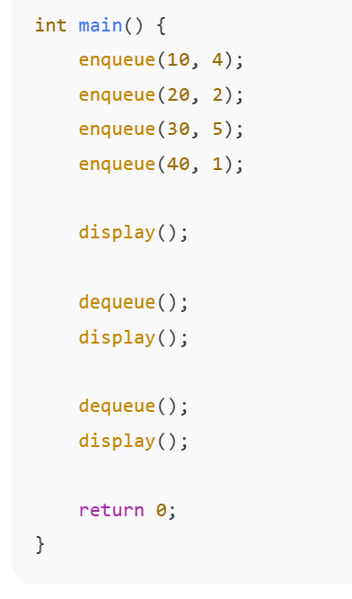
Priority Queue
Dattatray G Takale, Department of Computer engineering, VIT, Pune- 411037

Slide 12
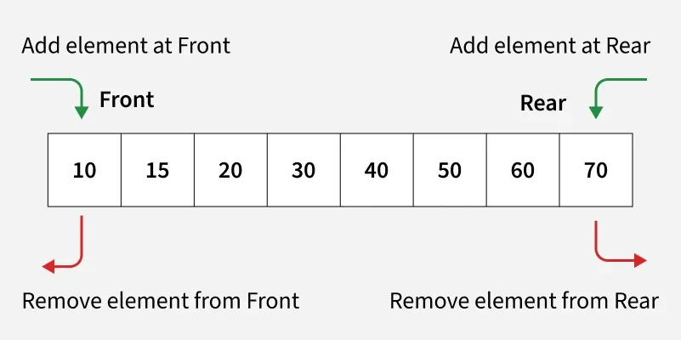
Double ended Queue
Deque or Double Ended Queue is a generalized version of Queue data structure that allows insert and delete at both ends. Below is an example program of deque in different languages.
Dattatray G Takale, Department of Computer engineering, VIT, Pune- 411037

Slide 13
Double ended Queue
Deque can act as both Stack and Queue
It is useful in many problems where we need to have a subset of all operations also like insert/remove at front and insert/remove at the end.
It is typically implemented either using a doubly linked list or circular array.
Dattatray G Takale, Department of Computer engineering, VIT, Pune- 411037

Slide 14
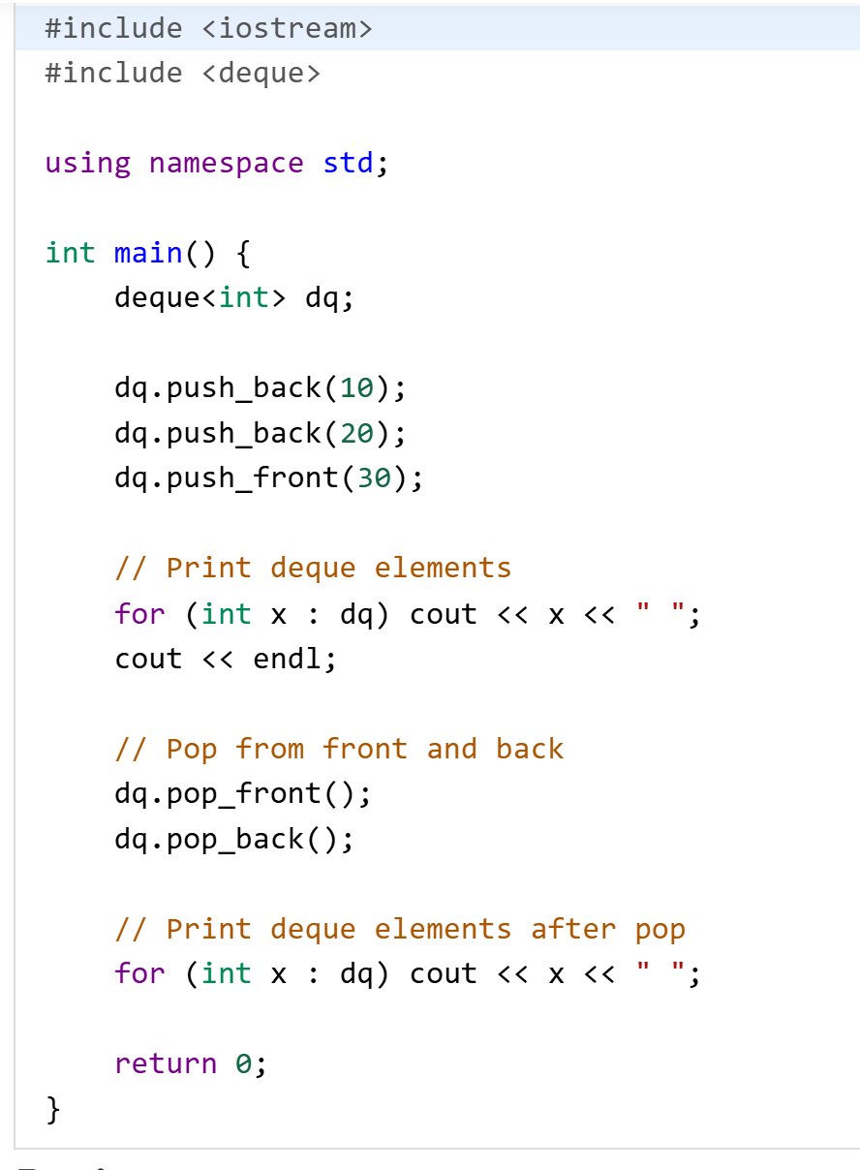
Double ended Queue
Dattatray G Takale, Department of Computer engineering, VIT, Pune- 411037

Slide 15
Single- and Double-Ended Priority Queues
A priority queue is a collection of elements such that each element has an associated priority.
For single-ended priority queues (SEPQ), the operations supported by a min priority queue are: 
P1: Return an element with minimum priority. minElement(); minKey(); 
P2: Insert an element with an arbitrary priority. insert(); 
P3: Delete an element with minimum priority. deleteMin(); 
Other ADTs: size(); isEmpty();
Problem in SEPQ
A normal (single-ended) priority queue supports only one type of deletion:
Type | Supported Operation
Min Priority Queue | Delete Min only
Max Priority Queue | Delete Max only
Dattatray G Takale, Department of Computer engineering, VIT, Pune- 411037

Slide 16
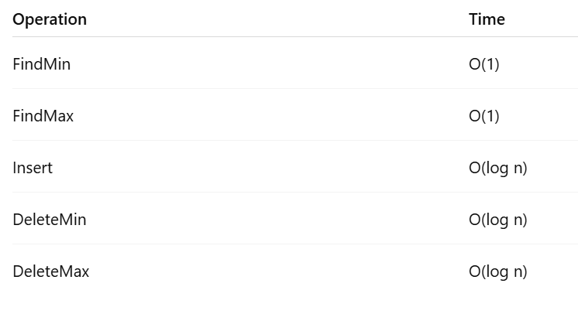
Single- and Double-Ended Priority Queues
Double-Ended Priority Queue (DEPQ)
A DEPQ is a priority queue that allows access and deletion of both minimum and maximum elements efficiently.
It supports operations from both ends:
Minimum end
Maximum end
Operations Supported in DEPQ
SP1: Return Minimum: FindMin(): Returns the smallest element without removing it.
SP2: Return Maximum: FindMax(): Returns the largest element without removing it.
SP3: Insert Element: Insert(x): Insert a new element with any priority.
SP4: Delete Minimum: DeleteMin(): Removes the smallest element.
SP5: Delete Maximum: DeleteMax(): Removes the largest element.
Dattatray G Takale, Department of Computer engineering, VIT, Pune- 411037

Slide 17
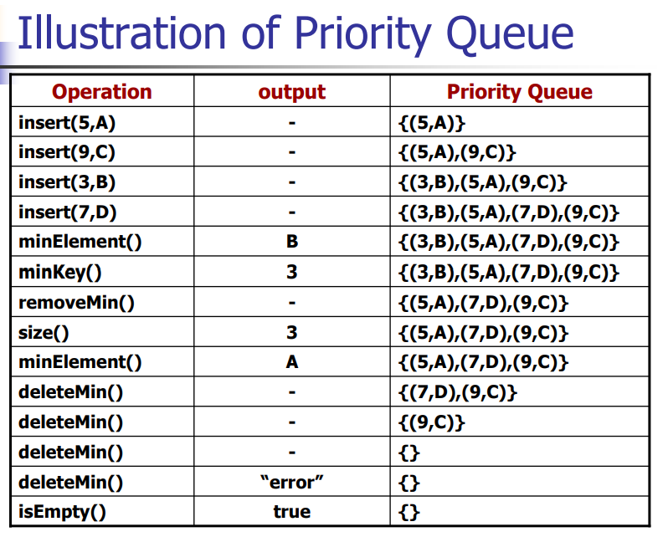
Single- and Double-Ended Priority Queues
Dattatray G Takale, Department of Computer engineering, VIT, Pune- 411037

Slide 18
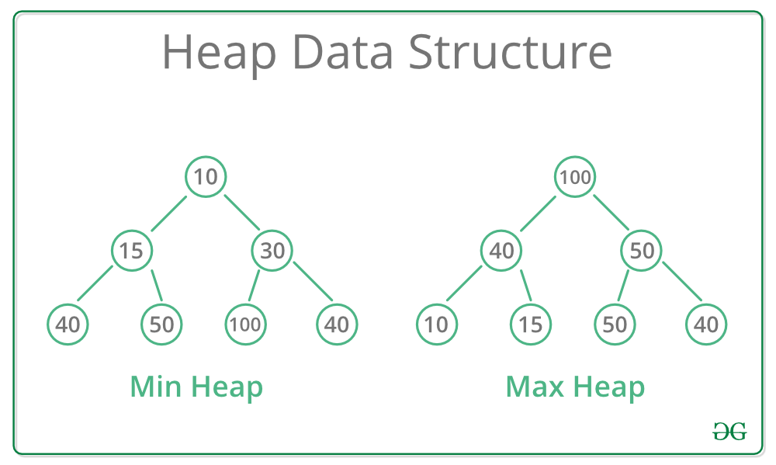
Heap Tree: Min Heap, Max Heap, Heap Sort
Introduction Heap
A heap data structure is a specialized binary tree used in DSA to efficiently manage priority queues. Here, we will discuss the basics of a heap tree in data structure, its types, and its significance in various algorithms, providing a foundational understanding for beginners.
There are two types of Heaps:
Min Heap: The value of the parent node is always less than or equal to the values of its children. The root node contains the smallest element.
Max Heap: The value of the parent node is always greater than or equal to the values of its children. The root node contains the largest element.
Dr. Dattatray G. Takale, Department of Computer engineering, VIIT, Pune-48

Slide 19
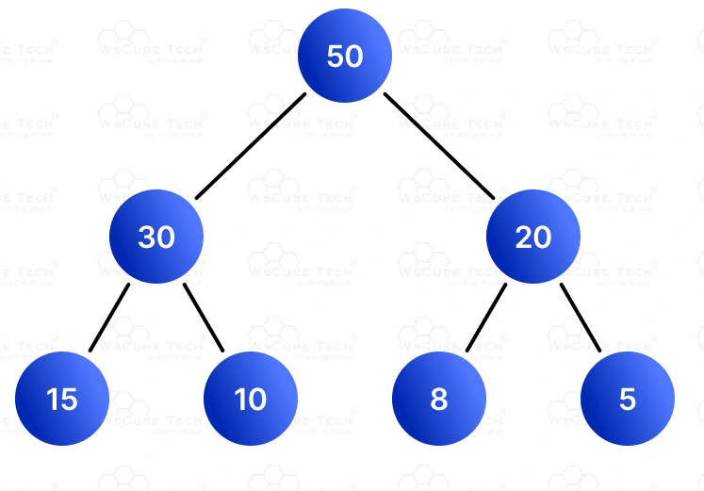
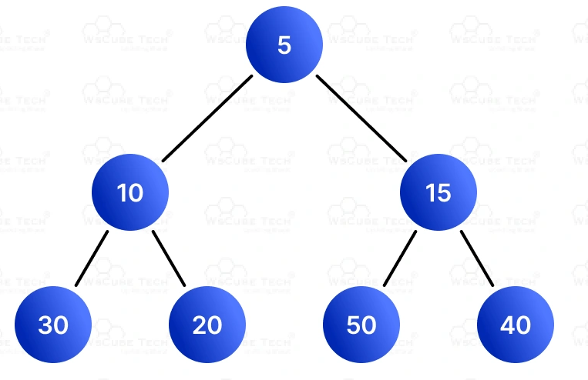
Heap Tree: Min Heap, Max Heap Introduction Heap
Characteristics of Heap Tree
A Heap Tree has the following important properties:
Complete Binary Tree:
All levels are completely filled except possibly the last.
Nodes are filled from left to right.
Heap Property
Determines the type of heap:
Max Heap :In a max-heap, each parent node is greater than or equal to its child nodes. This ensures that the largest value is always at the root of the tree.
Min Heap: In a min-heap, each parent node is less than or equal to its child nodes. This ensures that the smallest value is always at the root of the tree.
Array Representation:
Heaps are efficiently stored using arrays, not pointers.
Dr. Dattatray G. Takale, Department of Computer engineering, VIIT, Pune-48

Slide 20
Limitations of Binary Heap
While heaps are efficient, they have some drawbacks:
Merging two heaps is costly → O(n)
Structure must remain complete
Less flexible for some applications
To solve efficient merge (meld) operations, we use Leftist Trees.
Dr. Dattatray G. Takale, Department of Computer engineering, VIIT, Pune-48

Slide 21
Leftist Tree
A Leftist Tree is a special type of heap that is designed to merge quickly.
Its also called as Leftist Heap
In a Leftist Tree:
It follows Min Heap property
But it keeps the right side short
Tree becomes heavy on the left side
That’s why it is called Leftist
Linked binary tree.
Can do everything a heap can do and in the same asymptotic complexity.
insert
remove min (or max)
arbitrary remove (need parent pointers)
initialize
Can meld two leftist tree priority queues in O(log n) time.
Dr. Dattatray G. Takale, Department of Computer engineering, VIIT, Pune-48

Slide 22
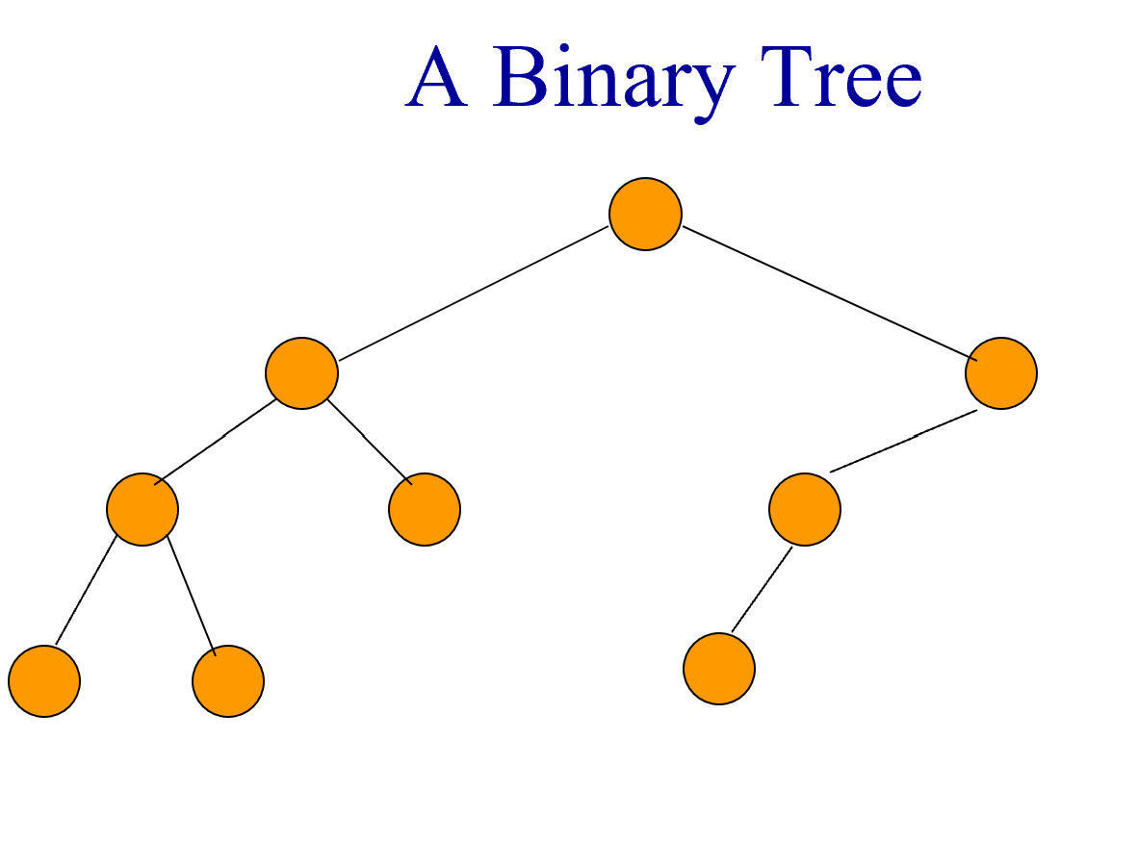
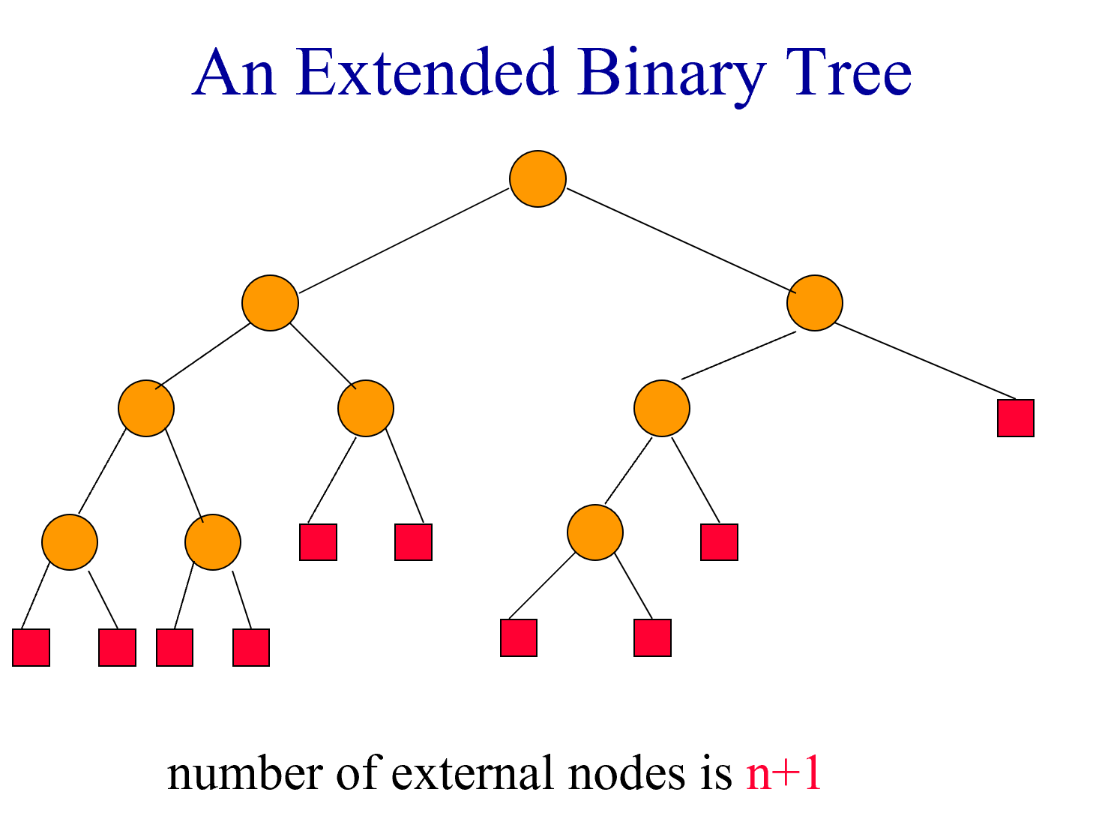
Leftist Tree
Start with any binary tree and add an external node wherever there is an empty subtree.
Result is an extended binary tree.
Dr. Dattatray G. Takale, Department of Computer engineering, VIIT, Pune-48

Slide 23
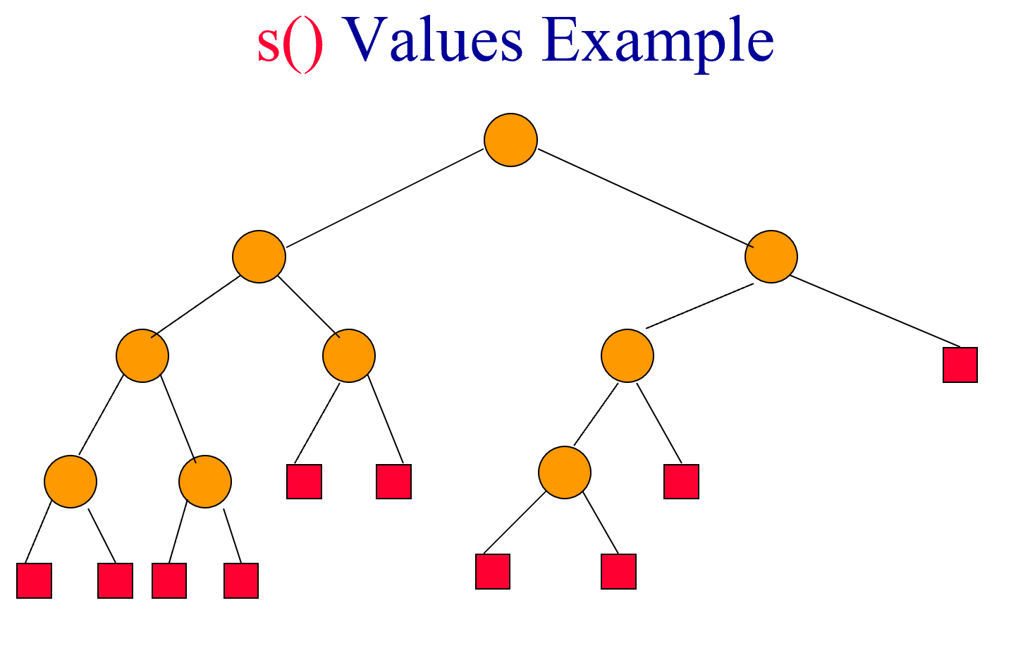
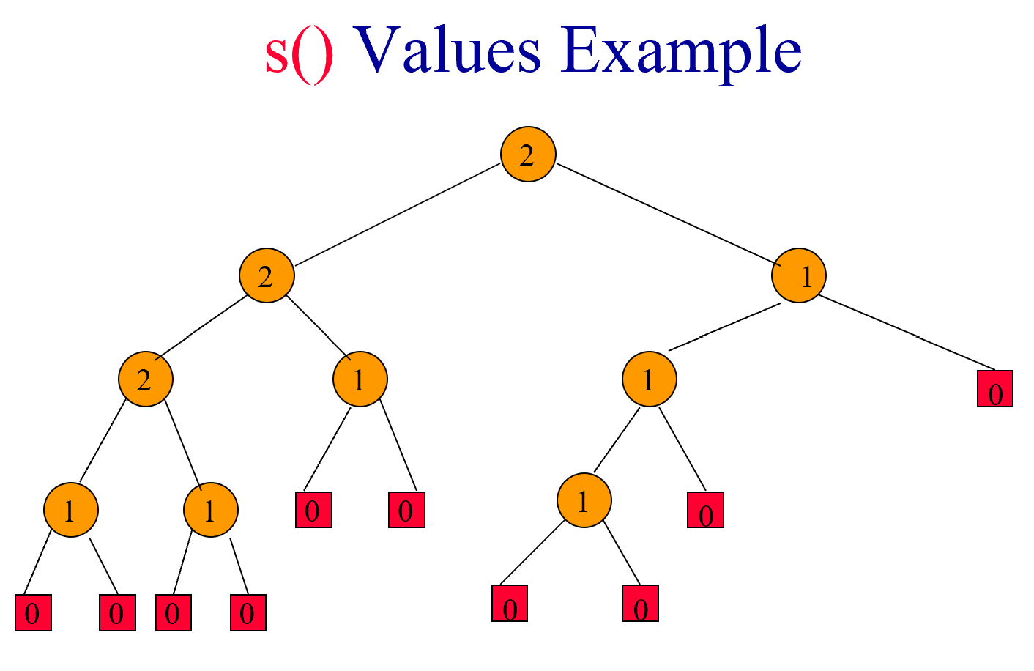
The Function s()
For any node x in an extended binary tree, let s(x) be the length of a shortest path from x to an external node in the subtree rooted at x.
Dr. Dattatray G. Takale, Department of Computer engineering, VIIT, Pune-48

Slide 24
Leftist Trees
Linked binary tree.
Can do everything a heap can do and in the same asymptotic complexity.
insert
remove min (or max)
arbitrary remove (need parent pointers)
initialize
Can meld two leftist tree priority queues in O(log n) time.
Dr. Dattatray G. Takale, Department of Computer engineering, VIIT, Pune-48
Notes:
Meld used in Edmonds directed minimum spanning tree algorithm, for e.g. We have super nodes. One priority queue for each supernode; has incoming edges. Extract edges until you get one that is not a self loop in the current supernode graph. Combine PQs when two supernodes are combined into one.
Leftist tree also supports arbitrary remove and satisfies the restrictions specified in a previous lecture for leaf correspondence.

Slide 25
The Function s()
For any node x in an extended binary tree, let s(x) be the length of a shortest path from x to an external node in the subtree rooted at x.
Dr. Dattatray G. Takale, Department of Computer engineering, VIIT, Pune-48

Slide 26
s() Values Example
Dr. Dattatray G. Takale, Department of Computer engineering, VIIT, Pune-48

Slide 27
s() Values Example
2
2
1
2
1
1
0
1
1
0
0
1
0
0
0
0
0
0
0
Dr. Dattatray G. Takale, Department of Computer engineering, VIIT, Pune-48

Slide 28
Properties Of s()
If x is an external node, then s(x) = 0.
Otherwise,
s(x) = min {s(leftChild(x)),
s(rightChild(x))} + 1
Dr. Dattatray G. Takale, Department of Computer engineering, VIIT, Pune-48
Notes:
s() values may be computed easily using a postorder traversal.

Slide 29
(Height Biased) Leftist Trees
A binary tree is a (height biased) leftist tree iff for every internal node x, s(leftChild(x)) >= s(rightChild(x))
So, in a leftist tree, s(x) = s(rightChild) + 1.
Dr. Dattatray G. Takale, Department of Computer engineering, VIIT, Pune-48
Notes:
By contrast, in a weight-biased leftist tree, w(leftChild(x)) >= w(rightChild(x)), w is the weight (#of nodes) in the subtree.

Slide 30
A Leftist Tree
2
2
1
2
1
1
0
1
1
0
0
1
0
0
0
0
0
0
0
s() decreases by 1 each time you move to a right child
how about when you move to a left child?
subtrees are also leftist trees
Dr. Dattatray G. Takale, Department of Computer engineering, VIIT, Pune-48
Notes:
Note that the s value decreases by 1 every time you move to a right child of a node. However, when you move to a left child, the s value may increase, though not in above example!
Every subtree also is a leftist tree.
Note also that every binary tree may be converted into a leftist tree by swapping left and right children whenever the leftist tree property is violated (use a postorder traversal, for example).

Slide 31
Leftist Trees – Property 1
In a leftist tree, the rightmost path is a shortest root to external node path and the length of this path is s(root).
Dr. Dattatray G. Takale, Department of Computer engineering, VIIT, Pune-48

Slide 32
A Leftist Tree
2
2
1
2
1
1
0
1
1
0
0
1
0
0
0
0
0
0
0
Length of rightmost path is 2.
Dr. Dattatray G. Takale, Department of Computer engineering, VIIT, Pune-48

Slide 33
Leftist Trees—Property 2
The number of internal nodes is at least
2^{s(root)} - 1
Because levels 1 through s(root) have no external nodes.
Dr. Dattatray G. Takale, Department of Computer engineering, VIIT, Pune-48

Slide 34
A Leftist Tree
2
2
1
2
1
1
0
1
1
0
0
1
0
0
0
0
0
0
0
Levels 1 and 2 have no external nodes.
Max # of internal nodes?
Dr. Dattatray G. Takale, Department of Computer engineering, VIIT, Pune-48
Notes:
Max nodes as a function of s(root)? No limit.

Slide 35
Leftist Trees—Property 3
Length of rightmost path is O(log n), where n is the number of (internal) nodes in a leftist tree.
Property 2 =>
n >= 2^{s(root)} – 1 => s(root) <= log₂(n+1)
Property 1 => length of rightmost path is s(root).
Dr. Dattatray G. Takale, Department of Computer engineering, VIIT, Pune-48

Slide 36
Leftist Trees As Priority Queues
Min leftist tree … leftist tree that is a min tree.
Used as a min priority queue.
Max leftist tree … leftist tree that is a max tree.
Used as a max priority queue.
Dr. Dattatray G. Takale, Department of Computer engineering, VIIT, Pune-48
Notes:
Min (max) tree→root of every subtree has min (max) value in the subtree

Slide 37
Leftist Trees As Priority Queues
Min leftist tree … leftist tree that is a min tree.
Used as a min priority queue.
Max leftist tree … leftist tree that is a max tree.
Used as a max priority queue.
Dr. Dattatray G. Takale, Department of Computer engineering, VIIT, Pune-48
Notes:
Min (max) tree→root of every subtree has min (max) value in the subtree

Slide 38
A Min Leftist Tree
2
4
3
6
8
5
8
6
9
Dr. Dattatray G. Takale, Department of Computer engineering, VIIT, Pune-48

Slide 39
Some Min Leftist Tree Operations
findMin()
put()
removeMin()
meld()
initialize()
put() and removeMin() use meld().
Dr. Dattatray G. Takale, Department of Computer engineering, VIIT, Pune-48

Slide 40
Put Operation
put(7)
2
4
3
6
8
5
8
6
9
Create a single node min leftist tree.
7
Meld the two min leftist trees.
Dr. Dattatray G. Takale, Department of Computer engineering, VIIT, Pune-48

Slide 41
Remove Min
2
4
3
6
8
5
8
6
9
Remove the root.
Dr. Dattatray G. Takale, Department of Computer engineering, VIIT, Pune-48

Slide 42
Remove Min
2
4
3
6
8
5
8
6
9
Remove the root.
Meld the two subtrees.
Dr. Dattatray G. Takale, Department of Computer engineering, VIIT, Pune-48

Slide 43
Meld Two Min Leftist Trees
4
3
6
8
5
6
8
6
9
Traverse only the rightmost paths so as to get logarithmic performance.
Dr. Dattatray G. Takale, Department of Computer engineering, VIIT, Pune-48

Slide 44
Meld Two Min Leftist Trees
4
3
6
8
5
6
8
6
9
Meld right subtree of tree with smaller root and all of other tree.
Make the result the new right subtree of the smaller root.
Swap left and right subtrees if needed.
Dr. Dattatray G. Takale, Department of Computer engineering, VIIT, Pune-48

Slide 45
Meld Two Min Leftist Trees
4
3
6
8
5
6
8
6
9
Meld right subtree of tree with smaller root and all of other tree.
Dr. Dattatray G. Takale, Department of Computer engineering, VIIT, Pune-48

Slide 46
Meld Two Min Leftist Trees
4
6
6
8
8
6
Meld right subtree of tree with smaller root and all of other tree.
Dr. Dattatray G. Takale, Department of Computer engineering, VIIT, Pune-48

Slide 47
Meld Two Min Leftist Trees
8
6
Meld right subtree of tree with smaller root and all of other tree.
Right subtree of 6 is empty. So, result of melding right subtree of tree with smaller root and other tree is the other tree.
Dr. Dattatray G. Takale, Department of Computer engineering, VIIT, Pune-48

Slide 48
Meld Two Min Leftist Trees
8
6
Make melded subtree right subtree of smaller root.
6
8
Swap left and right subtrees if s(left) < s(right).
6
8
Dr. Dattatray G. Takale, Department of Computer engineering, VIIT, Pune-48

Slide 49
Meld Two Min Leftist Trees
4
4
6
6
6
6
8
8
6
8
8
6
Make melded subtree right subtree of smaller root.
Swap left and right subtree if s(left) < s(right).
Dr. Dattatray G. Takale, Department of Computer engineering, VIIT, Pune-48

Slide 50
Meld Two Min Leftist Trees
3
5
4
9
6
6
8
6
8
Make melded subtree right subtree of smaller root.
Swap left and right subtree if s(left) < s(right).
Dr. Dattatray G. Takale, Department of Computer engineering, VIIT, Pune-48

Slide 51
Meld Two Min Leftist Trees
3
4
5
6
6
9
8
6
8
Dr. Dattatray G. Takale, Department of Computer engineering, VIIT, Pune-48

Slide 52
Initializing In O(n) Time
Create n single-node min leftist trees and place them in a FIFO queue.
Repeatedly remove two min leftist trees from the FIFO queue, meld them, and put the resulting min leftist tree into the FIFO queue.
The process terminates when only 1 min leftist tree remains in the FIFO queue.
Analysis is the same as for heap initialization.
Dr. Dattatray G. Takale, Department of Computer engineering, VIIT, Pune-48
Notes:
Alternatively, initialize a min heap and convert to min leftist tree.

Slide 53
Fibonacci Heaps
Procedure | Binary Heap | Binomial Heap | Fibonacci Heap
Make Heap | Θ(1) | Θ(1) | Θ(1)
Insert | Θ(log n) | Θ(log n) | Θ(1)
Min | Θ(1) | Θ(log n) | Θ(1)
Extract Min | Θ(log n) | Θ(log n) | Θ(log n)
Union | Θ(n) | Θ(log n) | Θ(1)
Decrease Key | Θ(log n) | Θ(log n) | Θ(1)
Delete | Θ(log n) | Θ(log n) | Θ(log n)
Dr. Dattatray G. Takale, Department of Computer engineering, VIIT, Pune-48
Notes:
Alternatively, initialize a min heap and convert to min leftist tree.

Slide 54
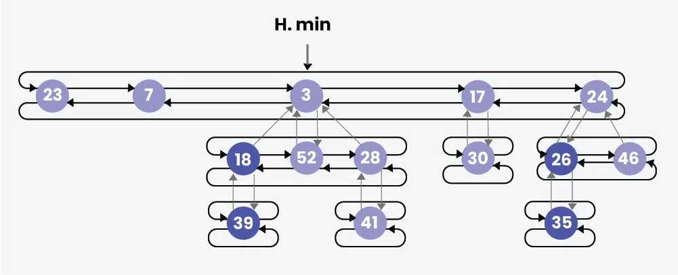
Fibonacci Heaps
Collection of trees with each tree following the heap ordering property.
Trees may be in any order in the root list (unlike Binomial Heaps).
A pointer to the minimum element of the heap is always maintained (min(H)).
Siblings are connected through a circular doubly linked list.
Each child points to its parent.
Each parent points to any one child.
Degree(x): Number of children of the root of a tree.
mark(x):
1 → Lost one of its children
0 → Lost no child
Dr. Dattatray G. Takale, Department of Computer engineering, VIIT, Pune-48
Notes:
Alternatively, initialize a min heap and convert to min leftist tree.

Slide 55
Skew Heaps
A Skew Heap is a self-adjusting heap used to implement priority queues.
It is similar to:
Leftist Heap
Binary Heap
But unlike Leftist Heap, it does not store Null Path Length (NPL).
Instead, it maintains balance automatically during merge operations.
Skew Heap is mainly designed to make merge operations efficient.
A Skew Heap is a heap-ordered binary tree where the left and right children of every node are swapped during merge operations to maintain balance.
Dr. Dattatray G. Takale, Department of Computer engineering, VIIT, Pune-48
Notes:
Alternatively, initialize a min heap and convert to min leftist tree.

Slide 56
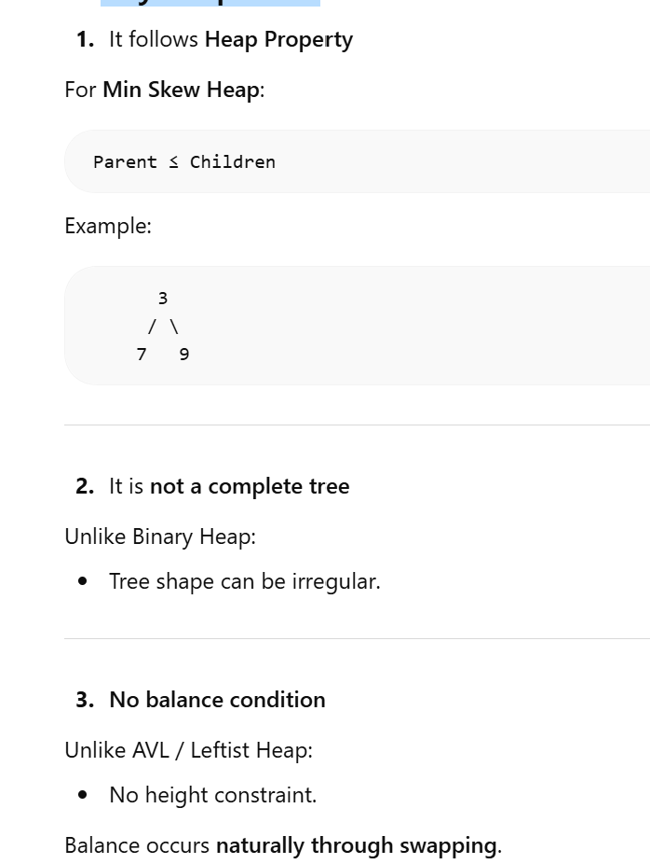
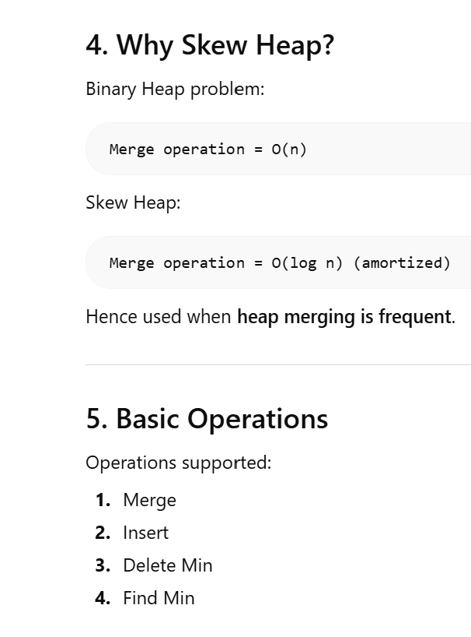
Skew Heaps
Properties of Skew Heaps
Dr. Dattatray G. Takale, Department of Computer engineering, VIIT, Pune-48
Notes:
Alternatively, initialize a min heap and convert to min leftist tree.

Slide 57
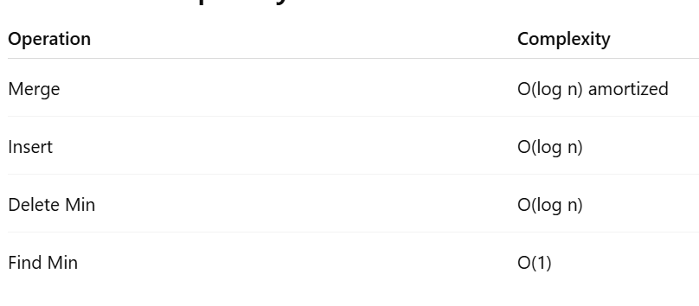
Skew Heaps
Algorithms of Skew Heaps
Recursive Merge Process : merge(h1, h2)
Let h1 and h2 be the two min skew heaps to be merged. Let h1's root be smaller than h2's root (If not smaller, we can swap to get the same).
We swap h1->left and h1->right.
h1->left = merge(h2, h1->left)
Skew heaps have the advantage that no extra space is required to maintain path lengths and no tests are required to determine when to swap children.
• It is an open problem to determine precisely the expected right path length of both leftist and skew heaps.
Dr. Dattatray G. Takale, Department of Computer engineering, VIIT, Pune-48
Notes:
Alternatively, initialize a min heap and convert to min leftist tree.

Slide 58
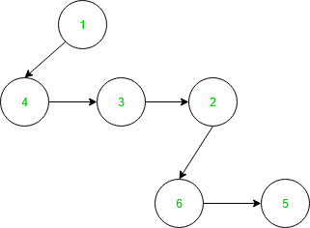
Pairing Heaps
Pairing Heap is like a simplified form Fibonacci Heap.
It also maintains the property of min heap which is parent value is less than its child nodes value.
It can be considered as a self-adjusting binomial heap. Each node has a pointer towards the left child and left child points towards the next sibling of the child.
A Pairing Heap is a heap-ordered tree used to implement priority queues.
It is similar to:
Fibonacci Heap
Skew Heap
But it is simpler to implement and performs very well in practice.
Pairing Heap is considered a practical alternative to Fibonacci Heap.
Example of Pairing Heap is given below:
Dr. Dattatray G. Takale, Department of Computer engineering, VIIT, Pune-48
Notes:
Alternatively, initialize a min heap and convert to min leftist tree.

Slide 59
Pairing Heaps
A Pairing Heap is a heap-ordered multiway tree where each node may have multiple children, and heap operations are performed using a pairing (merge) strategy.
Key Property
Pairing Heap follows the Heap Order Property:
For Min Heap:
Parent ≤ Children
Structure of Pairing Heap
Each node contains:
Key value
Pointer to first child
Pointer to next sibling
Basic Operations
Pairing Heap supports:
Insert
Find Min
Delete Min
Merge (Meld)
Decrease Key
Dr. Dattatray G. Takale, Department of Computer engineering, VIIT, Pune-48
Notes:
Alternatively, initialize a min heap and convert to min leftist tree.

Slide 60
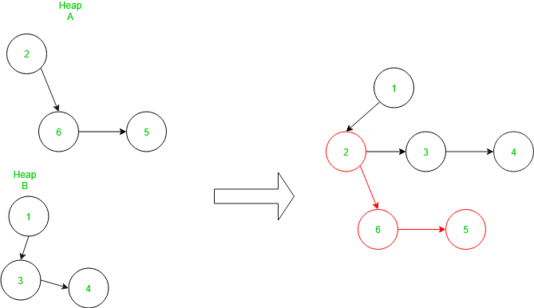
Pairing Heaps
Merge in Pairing Heap To join the two heap, first, we compare the root node of the heap if the root node of the first heap is smaller than the root node of the second heap then root node of the second heap becomes a left child of the root node of the first heap otherwise vice-versa. The time complexity of this process is O(1). Example of Merge is given Below:
Dr. Dattatray G. Takale, Department of Computer engineering, VIIT, Pune-48
Notes:
Alternatively, initialize a min heap and convert to min leftist tree.

Slide 61
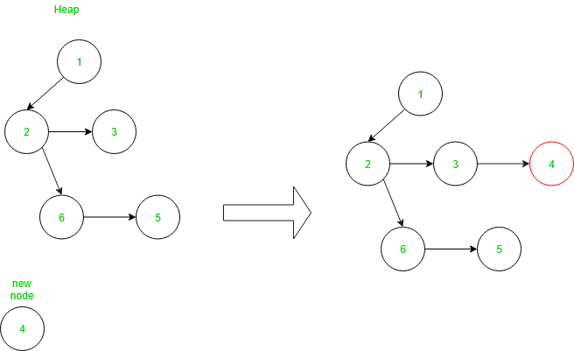
Pairing Heaps
Insertion in Pairing Heap: To insert a new node in heap, create a new node and Merge it with existing heap as explained above. Therefore, the time complexity of this function is O(1). Example of Merge is given Below:
Dr. Dattatray G. Takale, Department of Computer engineering, VIIT, Pune-48
Notes:
Alternatively, initialize a min heap and convert to min leftist tree.

Slide 62
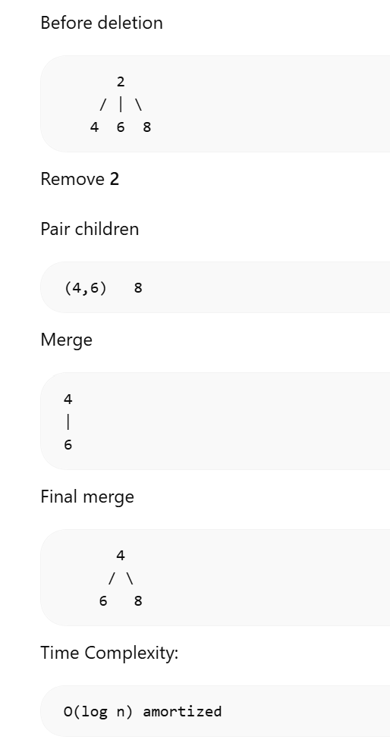
Pairing Heaps
Delete Minimum
Steps:
Remove root
Pair children from left to right
Merge pairs
Merge results again
Dr. Dattatray G. Takale, Department of Computer engineering, VIIT, Pune-48
Notes:
Alternatively, initialize a min heap and convert to min leftist tree.

Slide 63
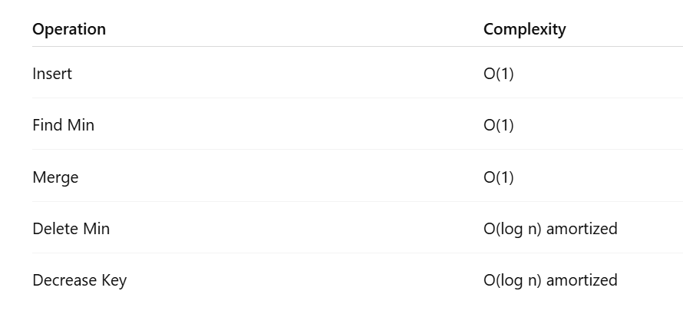
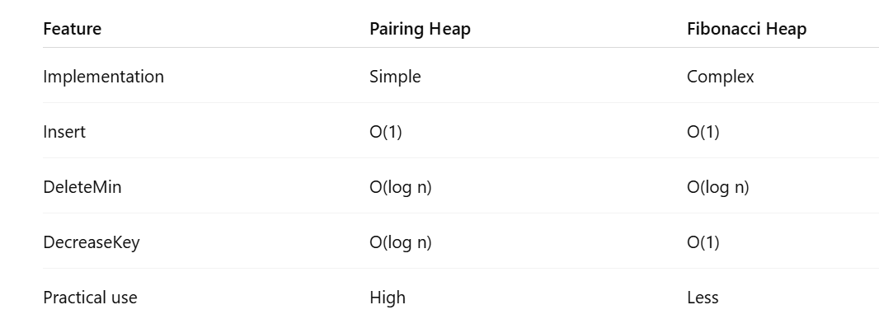
Pairing Heaps
Advantages
✔ Simple implementation ✔ Efficient in practice ✔ Good alternative to Fibonacci Heap
Applications
Pairing Heap is used in:
Priority queue implementation
Graph algorithms
Event simulation
Network optimization
Scheduling systems
Disadvantages
❌ Theoretical analysis is complex ❌ Worst case performance not fully understood
Dr. Dattatray G. Takale, Department of Computer engineering, VIIT, Pune-48
Notes:
Alternatively, initialize a min heap and convert to min leftist tree.

